Slide 1
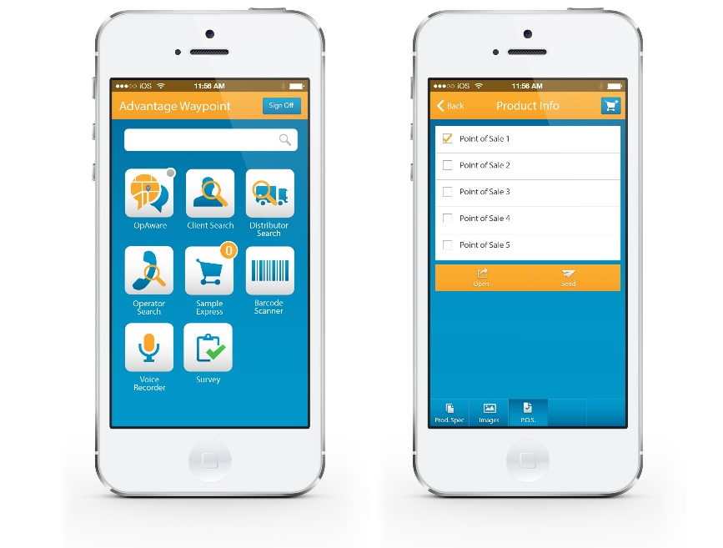
Advantage Waypoint Sales Team Mobile
What We Did
Built an application that runs natively on Android and iOS platforms to give both user types the unique interactive experience they expect from their phone interface.
We enabled two unique barcode scanners that access Advantage Waypoint’s large database, which contains hundreds of thousands of products and gives a user full image and information and can run a search on competitors’ products as an associate comes across them in the field, comparing them to the database and giving information for further assessment. Affirma ensured a successful deployment of the application and Advantage Waypoint is very happy with the results. The project ended under budget and the application is fully launched and currently in use.
5k
3
6 weeks
Increase of User Adoption
Responsive Viewport Sizes

Slide 2
Advantage Waypoint Sales Team Mobile
Business Need
Advantage Waypoint came to Affirma to transfer their sales function web portal to a mobile application. The app needed to include their large database of information for distributors, operators, and sales associates and adapt the processes into Android and iOS formatting to empower the sales staff and drive business decisions with the information they provide.
We took their existing enterprise customer relationship management program and created a mobile version that went above and beyond the current web functionalities.

